Slide 1

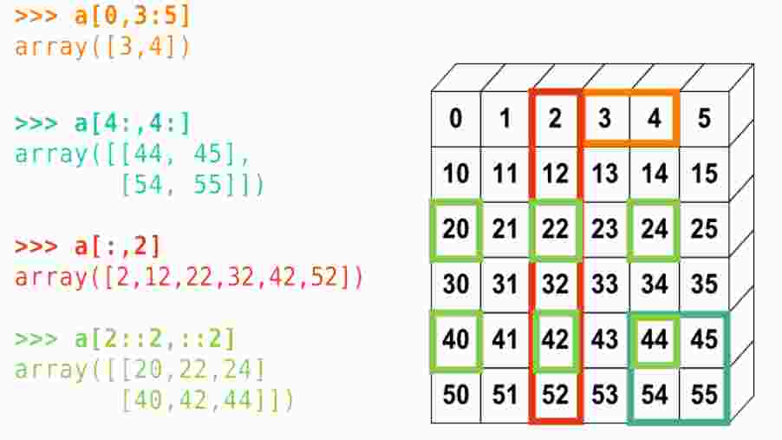
Module 3: Strings and Arrays (lists and sequences)

Slide 2
Sequences
“Omnia tempus habent, et suis spatiis transeunt universa sub caelo”
Ecclesiastes, 3-1
(There's a season for everything and a time for every matter under the heavens)

Slide 3

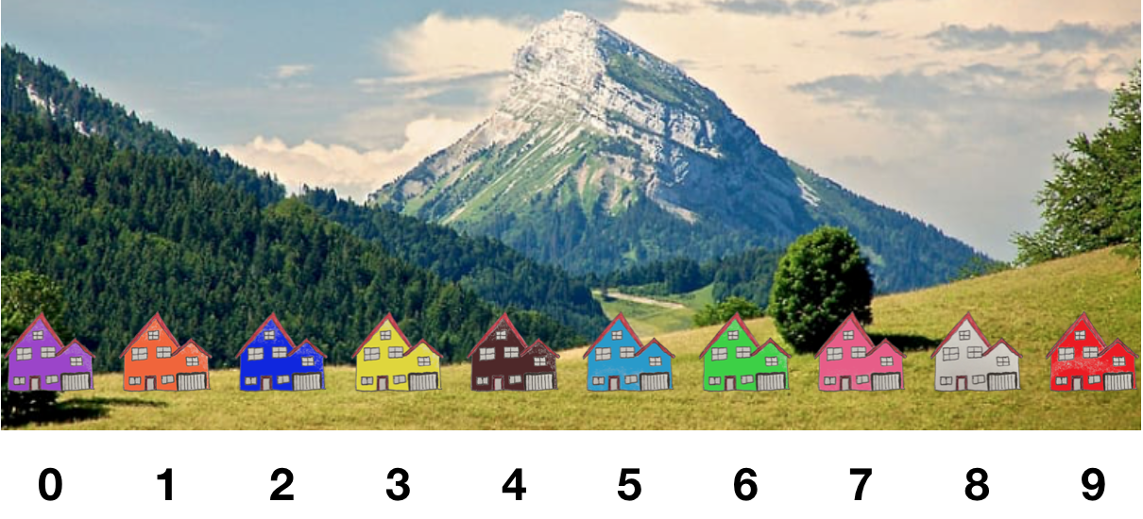
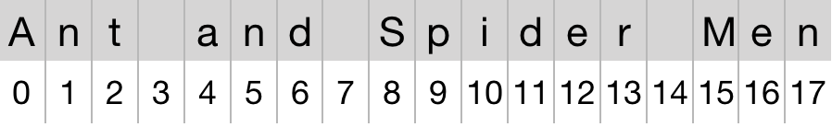
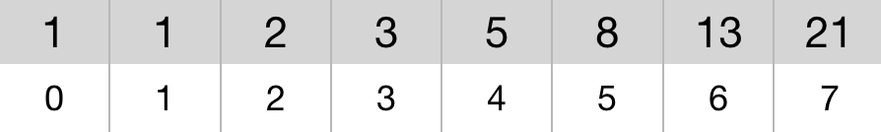
Sequences - an array variable
The indexing power of arrays
An orderly way to store information with direct access
A data structure with the same type of data, duly indexed
Usually characters or numbers, but actually any kind of data
For characters: strings
For numbers: vectors, matrices, tensors
Indexed from 0 to size-1 using brackets
Size given by built-in function len(<variable>)
string example
vector example

Slide 4
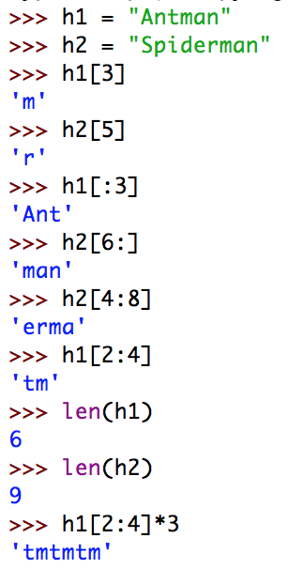
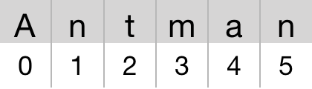
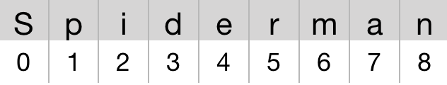
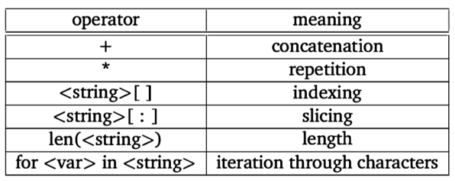
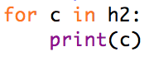
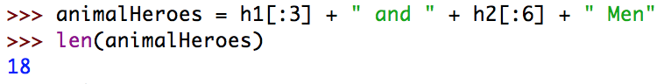
Strings - a sequence of characters
Strings are a basic data type in Python
h1
h2
Try this one:
animalHeroes

Slide 5
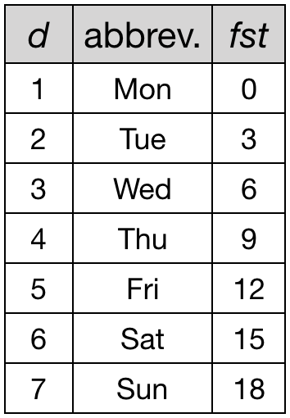
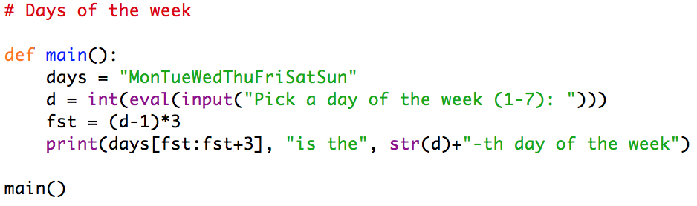
Example - Days of the Week
The Requirements
Given a string with day of the week abbreviations
MonTueWedThuFriSatSun
The user picks d from 1 to 7:
1 for Monday
2 for Tuesday
…
The program prints:
<abbreviation> is the <d>-th day of the week
The “algorithmic heart”
fst = (d-1)*3

Slide 6
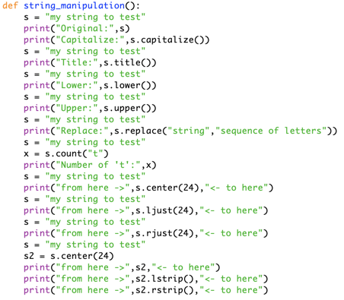
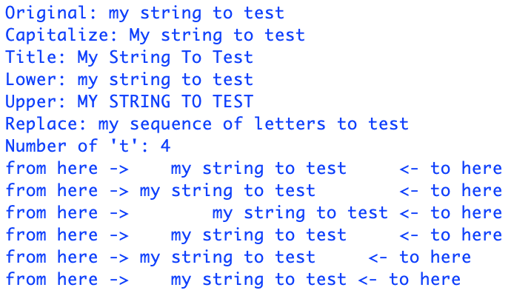
Strings - A few more methods
.capitalize() | .replace(<>,<>)
.title() | .count(<>)
.lower() | .find(<>)
.upper() | .center(#)
.lstrip() | .ljust(#)
.rstrip() | .rjust(#)

Slide 7
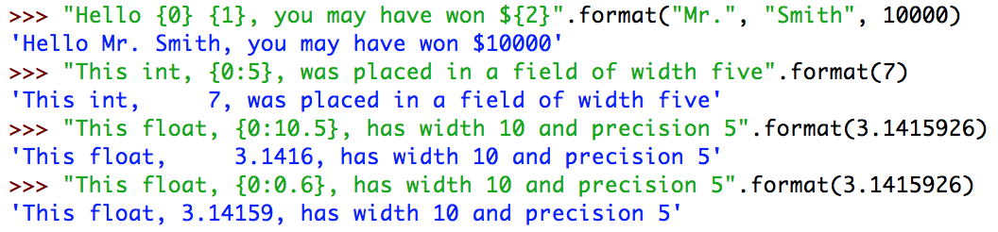
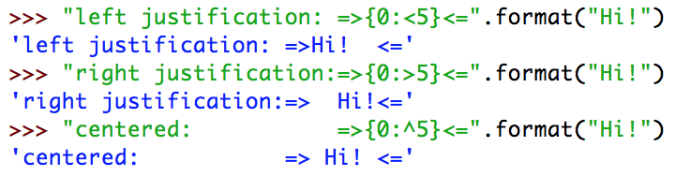
String Format - Templates
<template-string>.format(<values>)
<template-string>
{<idx>} those are slots
{<idx>:<specs>} those are formats
.format(<values>)
The expressions to be assigned to the slots

Slide 8
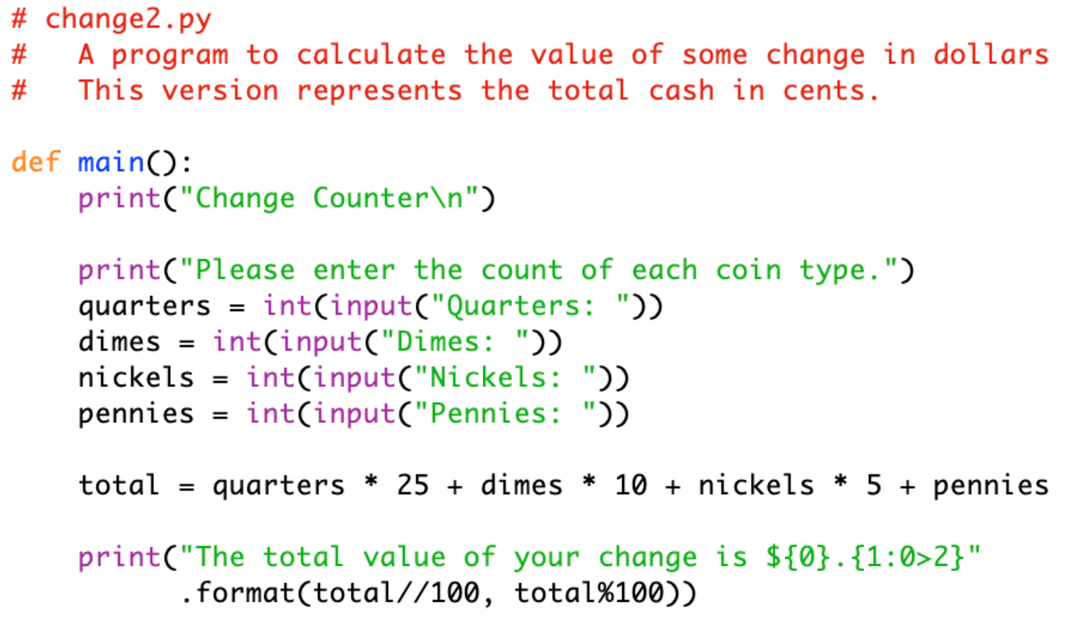
Example - Piggy Bank
A better formatting
Dollars free format
Cents with only two digits left justified
Try to change with different formatting

Slide 9
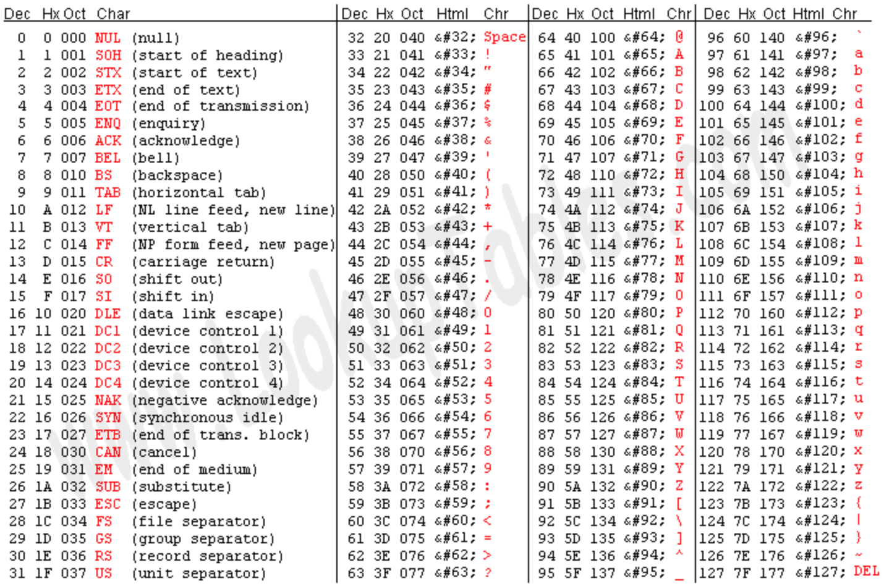
Encoding Characters for Strings
ASCII
128 symbols
32 “ ”
48 “0”
57 “9”
65 “A”
90 “Z”
97 “a”
122 “z”
UNICODE
UTF-8
UTF-16
UTF-32
Source: http://www.asciitable.com
ord(<>)
Char into Decimal
chr(#)
Decimal into Char

Slide 10
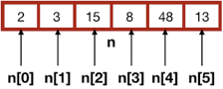
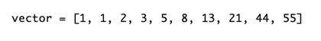
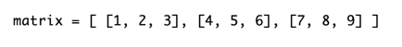

Lists - an array of variables
A string is a sequence of chars
A list is a sequence of:
Numbers
Strings
Lists
Objects (later…)
<variable> = [ <element>, …, <element>]
vector[6]
vector[:4]
months[5]
matrix[1][2]
matrix[1]
months[5][1]

Slide 11
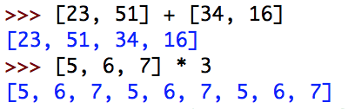
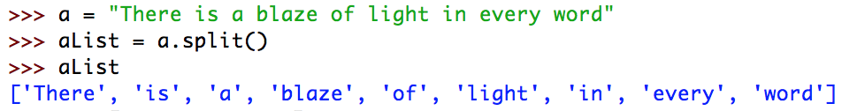
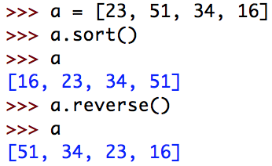
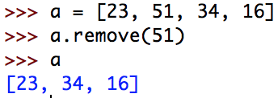
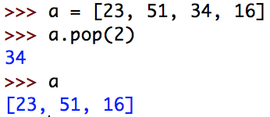
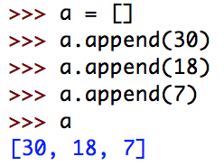
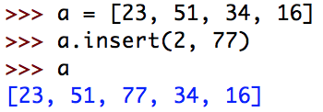
Lists - useful methods
Try them all!
+ concatenation
* replication
.split()
.reverse()
.sort()
.append(<element>
.remove(element)
.pop(#)
.insert(#, <element>)
.clear()

Slide 12
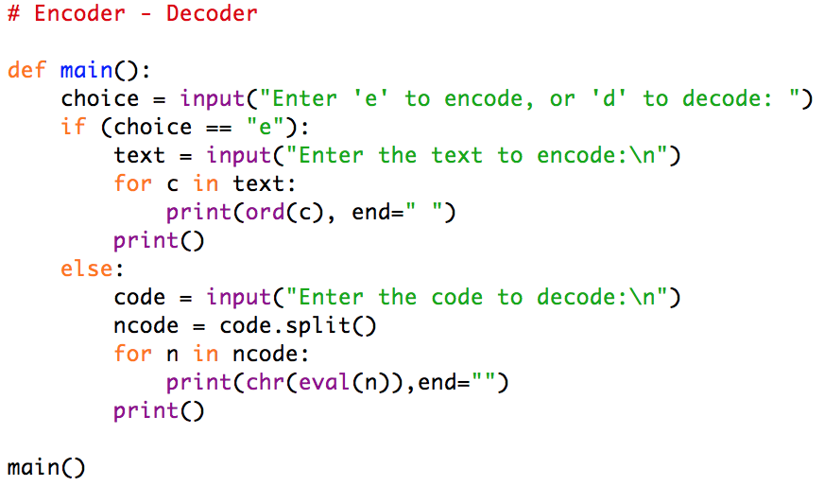
Example - Encoder - Decoder
The Requirements
Either:
Receives a text and convert it to Unicode
Receives an Unicode and convert it to text
The “algorithmic heart”
for all chars ord()
for all numbers chr()
It needs a split()

Slide 13
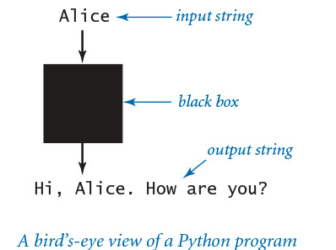
Input and output
The simplest way to provide input data is illustrated in useargument.py (PROGRAM 1.1.2). Whenever you run the program useargument.py, it accepts the command-line argument that you type after the program name and writes it back out to the terminal as part of the message. The result of executing this program depends on what you type after the program name. You can run the program with different command-line arguments and get different written results.
In useargument.py, the statement import sys tells Python that you wish to use the features defined in the sys module. One of those features, named argv, is a list of command-line arguments (which appear after “python useargument.py” on the command line, delimited by spaces). sys.argv[1] is the first command-line argument that you type after the program name, sys.argv[2] is the second command-line argument that you type after the program name, and so forth. You can use sys.argv[1] within your program’s body to represent the string that you type on the command line when you execute it, just as in useargument.py.

Slide 14
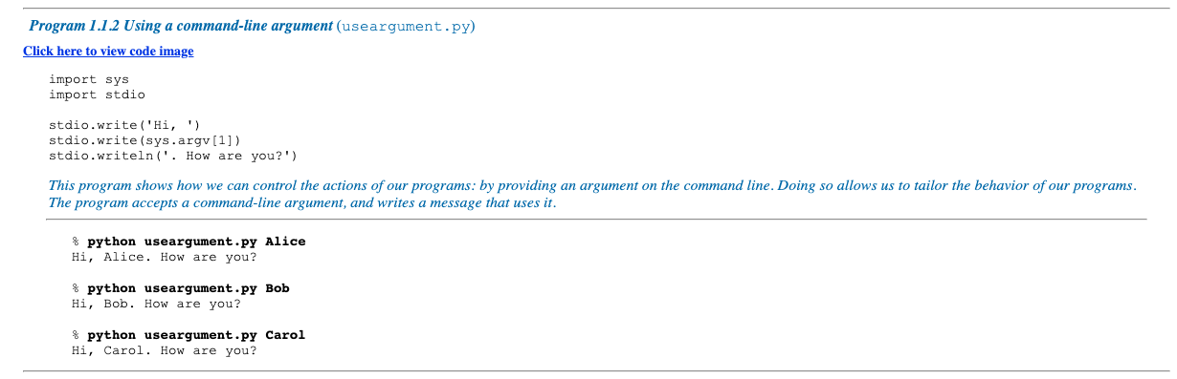
Another basic function of a program is its ability to respond to basic information from the user to control what the program does. The simple model that useargument.py represents will suffice to allow us to consider Python’s basic programming mechanism and to address all sorts of interesting computational problems.
Stepping back, we can see that useargument.py does neither more nor less than map a string of characters (the argument) into another string of characters (the message written back to the terminal). When using it, we might think of our Python program as a black box that converts our input string to some output string.

Slide 15
Converting numbers to strings for output
Python provides the built-in function str() to convert numbers to strings. For example, str(123) evaluates to the str object '123', and str(123.45) evaluates to the str object '123.45'. If the argument to either stdio.write() or stdio.writeln() is not of type str, then these two functions automatically call the str() function on its argument to generate the string representation. For example, stdio.write(123), stdio.write(str(123)), and stdio.write('123') all write 123.
Our most frequent use of the string concatenation operator is to chain together the results of a computation for output with stdio.write() and stdio.writeln(), often in conjunction with the str() function, as in this example:
stdio.writeln(str(a) + ' + ' + str(b) + ' = ' + str(a+b))
If a and b are int objects whose values are 1234 and 99, respectively, then that statement writes the line of output 1234 + 99 = 1333. We consider the str data type first precisely because we need it to produce this sort of output in programs that process other types of data.

Slide 16
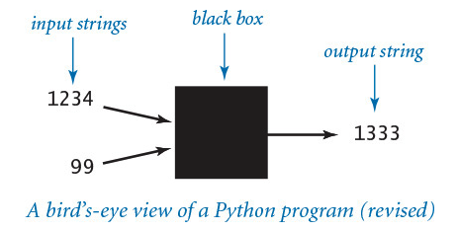
Converting strings to numbers for input
Python also provides built-in functions to convert strings (such as the ones we type as command-line arguments) to numeric objects. We use the Python built-in functions int() and float() for this purpose. For example, typing int('1234') in program text is equivalent to typing the int literal 1234. If the user types 1234 as the first command-line argument, then the code int(sys.argv[1]) also evaluates to the int object whose value is 1234. You will see several examples of this usage in this section.
With these features, our view of each Python program as a black box that takes string arguments and produces string results is still valid, but we can now interpret those strings as numbers and use them as the basis for meaningful computation.

Slide 17
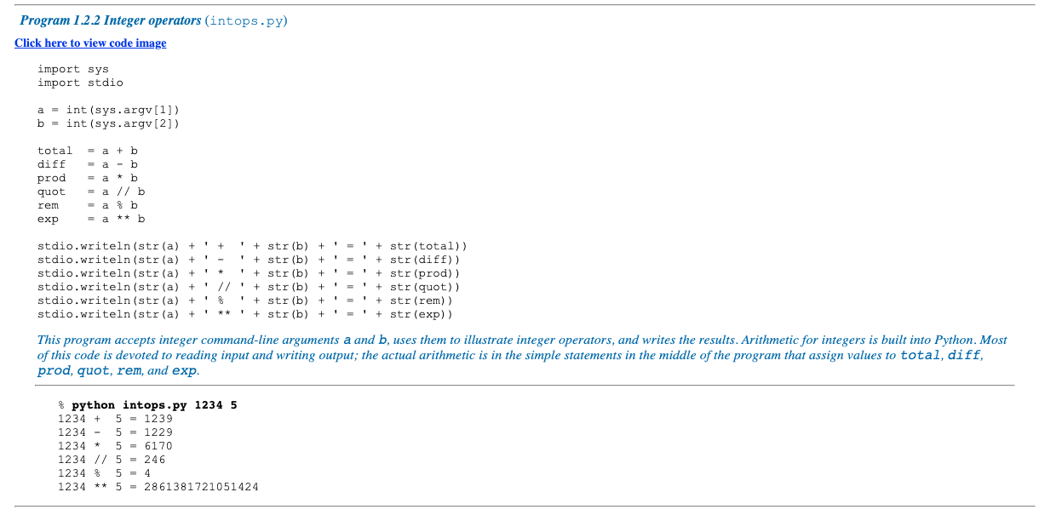

Slide 18
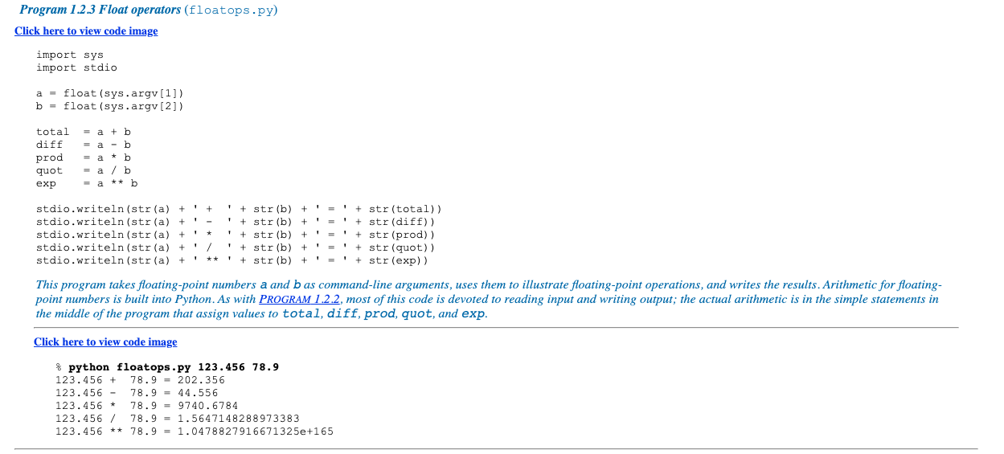

Slide 19
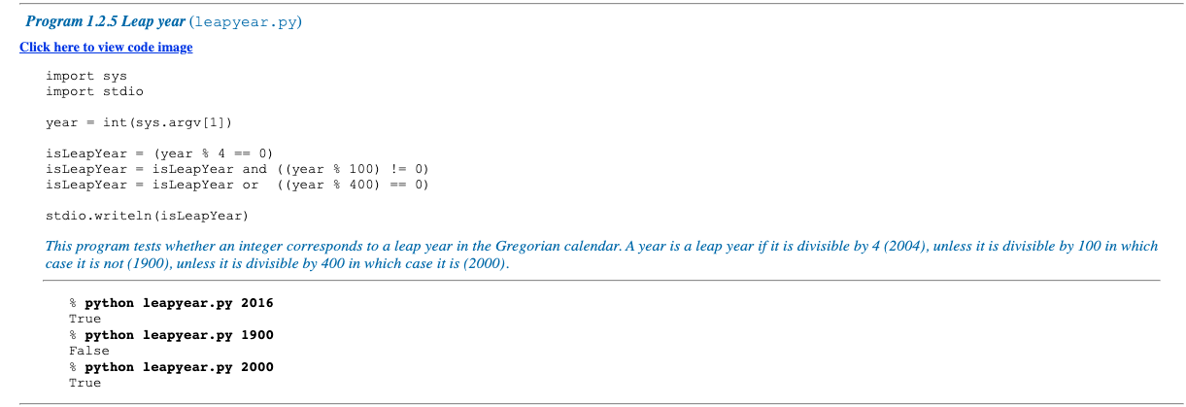
Functions and APIs
As we have seen, many programming tasks involve using not only built-in operators, but also functions that perform useful operations. We distinguish three kinds of functions: built-in functions (such as int(), float(), and str()) that you can use directly in any Python program, standard functions (such as math.sqrt()) that are defined in a Python standard module and are available in any program that imports the module, and booksite functions (such as stdio.write() and stdio.writeln()) that are defined in our booksite modules and available for you to use after you have made them available to Python and imported them.

Slide 20
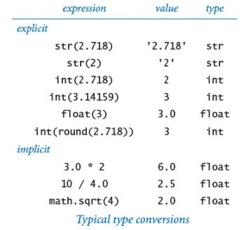
Type conversion
Typical programming tasks involve processing multiple types of data. You should always be aware of the type of data that your program is processing, because only by knowing the type can you know precisely which set of values each object can have and which operations you can perform. In particular, we often need to convert data from one type to another.
The problem stems from the fact that the operands are integers, but it is natural to expect a float for the result, so conversion from integer to float is necessary at some point. There are two ways to do so in Python.
Explicit type conversion
One approach is to use a function that takes an argument of one type (the object to be converted) and returns an object of another type. We have already used the built-in functions int(), float(), and str() to convert from strings to integers or floats, and vice versa.

Slide 21
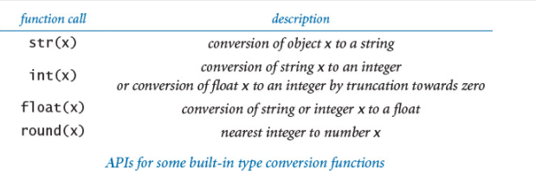

Slide 22
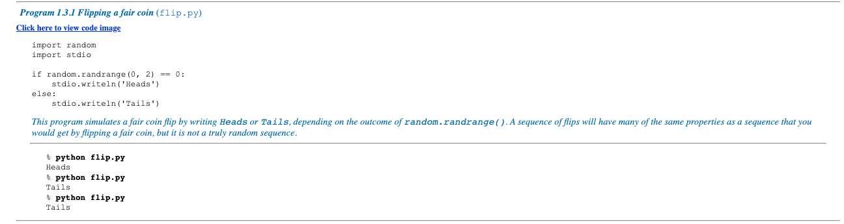

Slide 23
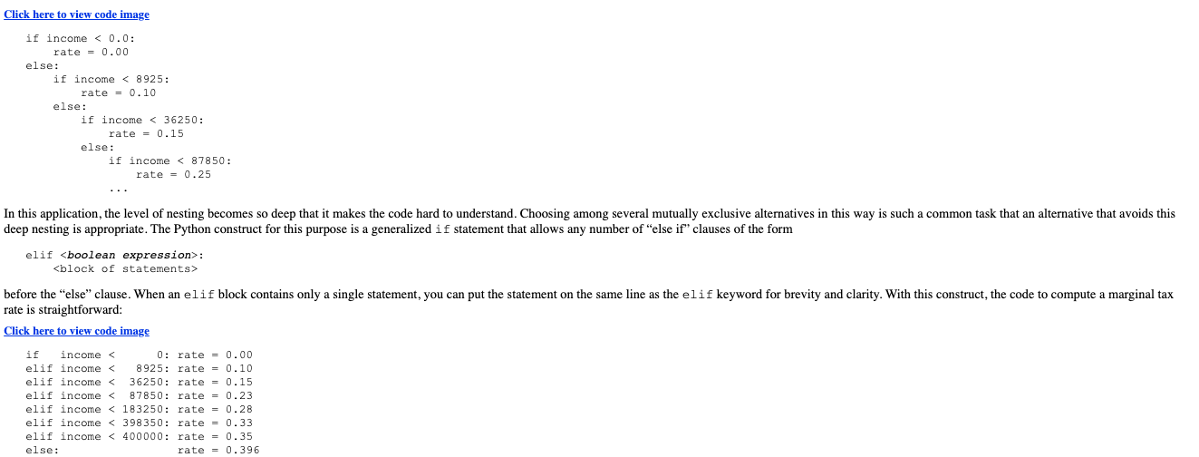

Slide 24
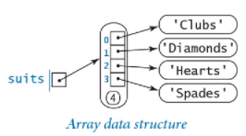
Arrays in Python
The simplest way to create an array in Python is to place comma-separated literals between matching square brackets. For example, the code
suits = ['Clubs', 'Diamonds', 'Hearts', 'Spades']
creates an array suits[] with four strings, and the code
x = [0.30, 0.60, 0.10]
y = [0.40, 0.10, 0.50]

Slide 25
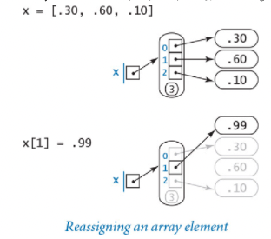
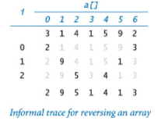
Mutability
An object is mutable if its value can change. Arrays are mutable objects because we can change their elements

Slide 26
Recording temperatures 4 times a day, every day for 5 days
One way
Day 1 - 11 12 5 2
Day 2 - 15 6 10
Day 3 - 10 8 12 5
Day 4 - 12 15 8 6
Day 5 - 11 13 9 2
OR
from array import *
T = [[11, 12, 5, 2], [15, 6,10], [10, 8, 12, 5], [12,15,8,6], [11,13,9,2]] for r in T:
for c in r:
print(c,end = " ")
print()

Slide 27
Declaring and initializing 2D arrays
# Using above first method to create a
# 2D array
rows, cols = (5, 5)
arr = [[0]*cols]*rows
print(arr)
Output: [[0, 0, 0, 0, 0], [0, 0, 0, 0, 0], [0, 0, 0, 0, 0], [0, 0, 0, 0, 0], [0, 0, 0, 0, 0]]
# Using above second method to create a
# 2D array
rows, cols = (5, 5)
arr = [[0 for i in range(cols)] for j in range(rows)]
print(arr)

